Slide 1


Scholarli
Notes:
Talk about description from the project introduction

Slide 2
Meet the Team
Juan Rodriguez | Kevin Tran | Thau Tran-Nguyen
Computer Science | Computer Science | Electrical Engineering
Notes:
Talk about the team and a brief description of everyone’s involvement

Slide 3
Mission Statement
Scholarli is a mobile application tasked with providing user with a new and efficient way to organize their semester assignments
Notes:
Talk about scope in SRS, SDD and STD

Slide 4
The Problem
Lacks the function to organize by semester
Lacks notifications
Lacks student customization

Slide 5
The Solution
Cross Platform (Android, iOS, Web, etc.)
Semester Based
Simple
Smart Notifications
Notes:
Talk about the feature of our app
Smart notifications: gives notifications based on studies of academic efficiency

Slide 6
Feasibility Report
Existing assignment trackers and methods are not efficient and organized enough:
Canvas
Excel Sheet
MyStudyLife
Notion
Notes:
Talk about the feasibility report from the project introduction

Slide 7
User Interface
Registration and Login
Semester Page, View Semester
Display All Course
Add/Delete Course
Add/Edit/Delete Assignments
Notifications

Slide 8


Hardware and Software Interface

Slide 9
Functional Requirements
Validity Check on Inputs
Exact Sequence of Operations
Response to Abnormal Situation
Effect of Parameters

Slide 10
Non-Functional Requirements
Reliability
Availability
Security
Maintainability
Portability
Performance

Slide 11
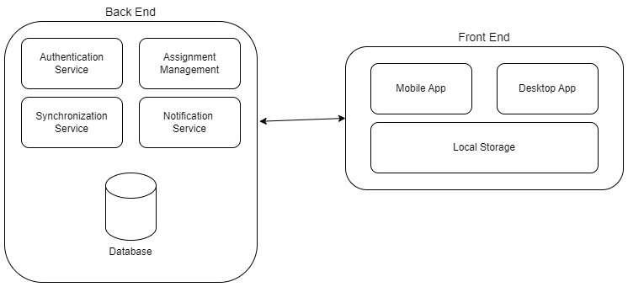
System Overview

Slide 12
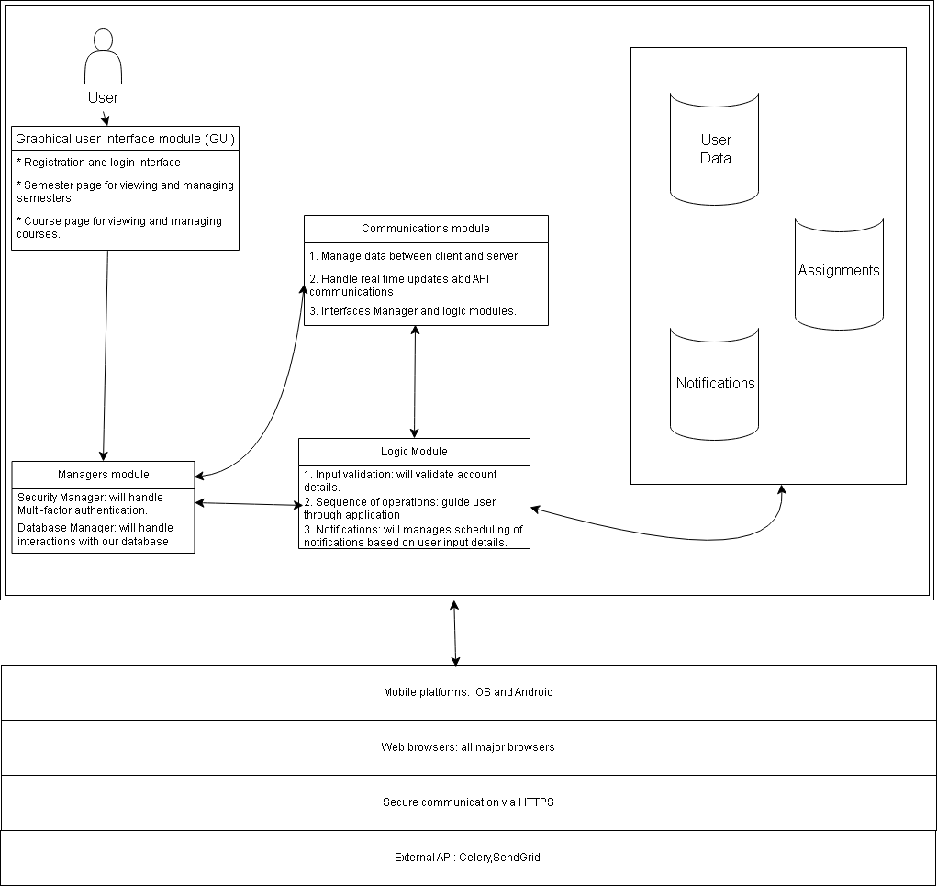
System Architecture

Slide 13
Decomposition Description

Slide 14
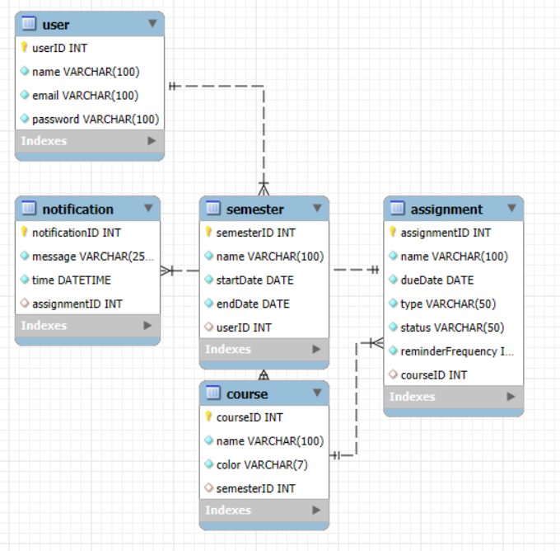
ER Diagram

Slide 15
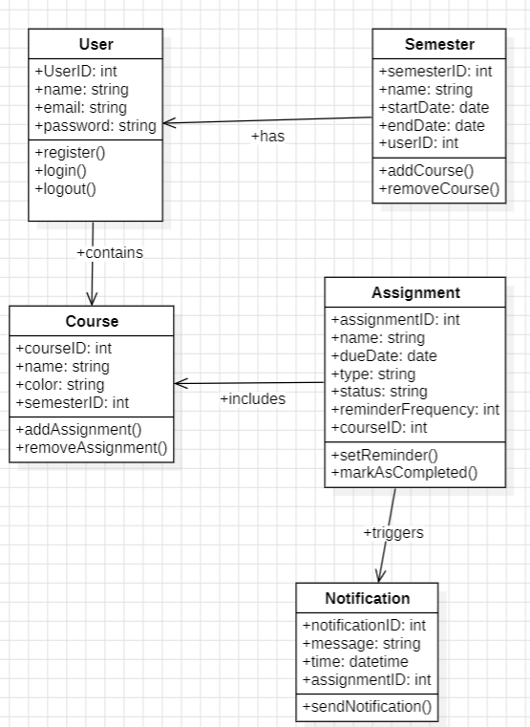
Object Class Diagram

Slide 16
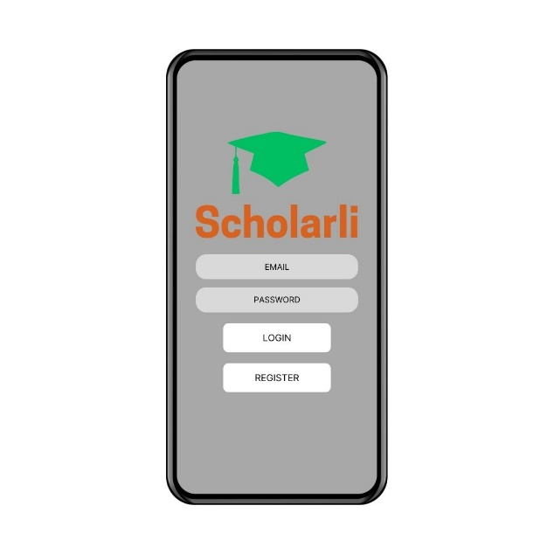
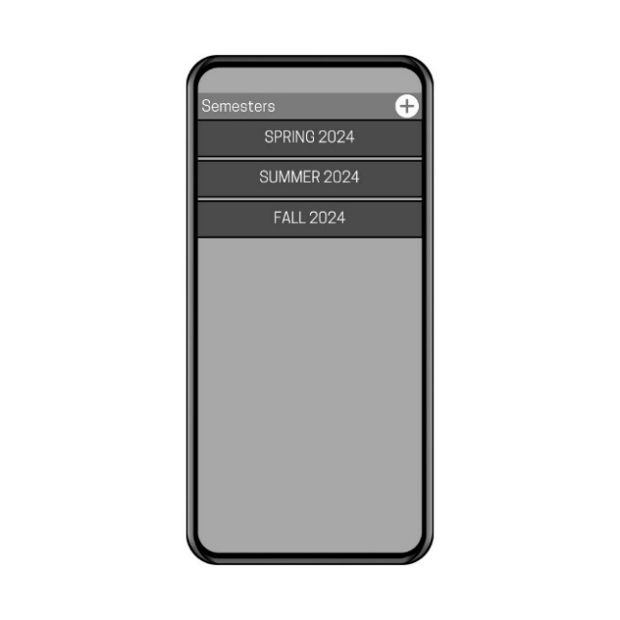
Screen Images of Scholarli
Notes:
Explain the images

Slide 17
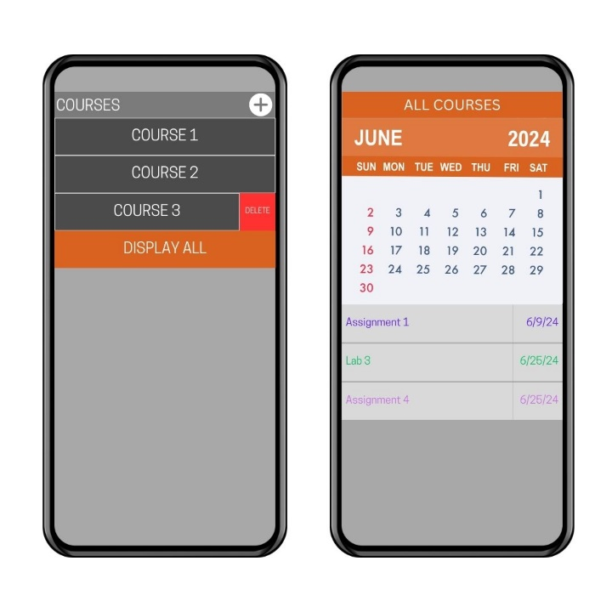
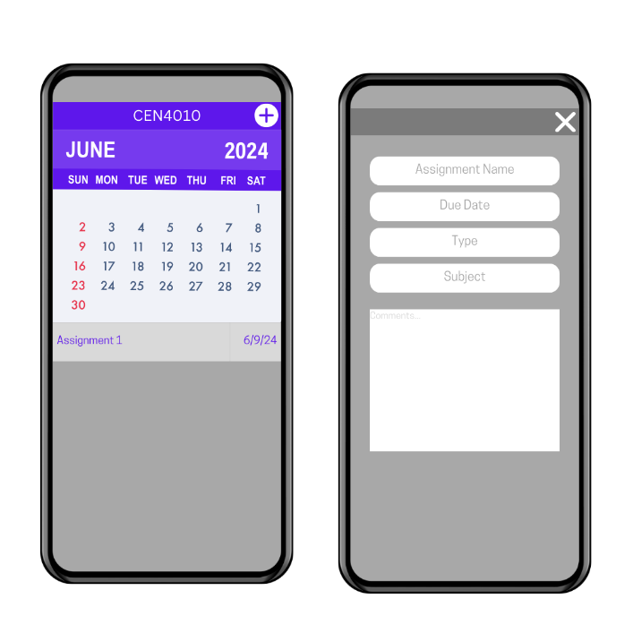
Screen Images of Scholarli
Notes:
Explain the images

Slide 18
Staffing Requirements
Roles and Responsibilities
Project Lead
UX/UI Designer
Front-end Developer
Back-end Developer
QA Tester
Skillset
Programming Languages
Mobile Development Framework:
UI/UX: Sketch, Figma
Database Management
QA Testing
Project Management

Slide 19
Schedule for Scholarli
Milestone 1
Milestone 2
Milestone 3
Milestone 4

Slide 20
Schedule for Scholarli
Milestone 1:
Week 1 - 2

Slide 21
Schedule for Scholarli
Milestone 1:
Week 1 - 2
Milestone 2:
Week 3 - 6

Slide 22
Schedule for Scholarli
Milestone 1:
Week 1 - 2
Milestone 2:
Week 3 - 6
Milestone 3:
Week 7 - 10

Slide 23
Schedule for Scholarli
Milestone 1:
Week 1 - 2
Milestone 2:
Week 3 - 6
Milestone 3:
Week 7 - 10
Milestone 4:
Week 11 - 12

Slide 24
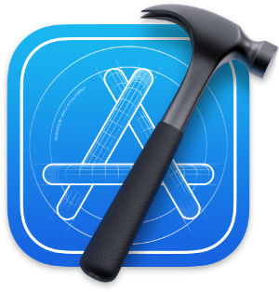







Tools for Development and Testing
Notes:
Android Studio
Xcode
Qt Creator
Junit 5 for Android testing
Espresso for Android testing
SQL for databases
XCTest for iOS testing
Jira for project management

Slide 25
References
https://github.com/KatherineSantore/AssignmentTracker_Client
https://www.researchgate.net/figure/High-level-software-architecture-of-DSMS_fig5_332656904
Celery task scheduler: https://docs.celeryq.dev/en/main/userguide/periodic-tasks.html
SendGrid email API: https://sendgrid.com/en-us
When and how to study for a quiz or test: https://www.asundergrad.pitt.edu/study-lab/study-skills-tools-resources/seven-day-test-prep-plan
Schedule IT: https://github.com/anxalivn/Schedule-IT
myHomework App: https://myhomeworkapp.com/
Notion: https://www.notion.so/templates/assignment-tracker-2
MYSTUDYLIFE: https://mystudylife.com/
Excel Assignment Schedule: https://create.microsoft.com/en-us/template/assignment-schedule-3445dcd8-2047-4602-8056-ea5c30d95b19

